Slide 1

Network Security Real Time Anomaly Detection Email QR And URL Analysis
Team Members:
Akshat Kumar Nautiyal – 235339026
Shivam Bhandari - 235339027
Tina Mathpal - 235339045
Team Members:
Akshat Kumar Nautiyal – 235339026
Shivam Bhandari - 235339027
Tina Mathpal - 235339045
Mentor:
Dr. Rakesh Kumar Saini
Mentor:
Dr. Rakesh Kumar Saini

Slide 2
Introduction
In an era of rising cyber threats, this project presents real-time network anomaly detection and phishing URL analysis, particularly focusing on threats hidden in email QR codes and URLs.
Traditional defenses like firewalls and signature-based antivirus tools often fall short in identifying Dos attack and evasive phishing tactics.

Slide 3
Related Work
Author | Accuracy | Dataset | Advantage | Disadvantage
Bian Hui et al. [2] | 93.72% | NSL-KDD | Hybrid CNN-LSTM improves detection metrics over traditional ML. | Dataset is outdated; lacks real-time adaptability.
Saba Aslam et al. [4] | 96.04% | Alexa + PhishTank | Two-phase LSTM-ML with char-TFIDF enhances generalization. | High computational cost; limited to text-based URL analysis.
Ume Zara et al. [6] | 98.9% | Kaggle | Ensemble of RF, DT, LSTM, GRU boosts phishing detection performance. | Risk of overfitting; lacks QR code and image-based phishing detection.
Aniket Garje et al. [3] | 94–98.4% | PhishTank, DMOZ | Strong results with Decision Tree and Random Forest using simple features. | Heavily reliant on manual feature engineering; lacks DL scalability.
Wooseok Seo et al. [5] | 99.98% | Real-time network traffic | High accuracy and real-time detection using session-based AI-IDS. | High deployment complexity; limited access to proprietary dataset.
Ming-Chang Lee et al. [1] | 99.1% | Open-source time series | Effective real-time detection with LSTM in PyTorch framework. | Performance varies by framework; not focused on phishing use cases.

Slide 4
Problem Statement
QR codes and short URLs often evade detection.
Need for real-time, intelligent security systems.

Slide 5
Feasibility Study
Technical Feasibility
Machine Learning Integration: The system employs real-time anomaly detection and QR-based phishing analysis, leveraging advanced machine learning models for accurate threat detection.
Operational Feasibility
Efficient Threat Detection: Provides alerts mechanisms.
Minimal Maintenance: Requires periodic model updates but does not heavily depend on manual oversight.

Slide 6
Feasibility Study Continued…
Economic Feasibility
Cost-Effective Solution: Machine learning-based detection reduces dependency on expensive traditional security tools.

Slide 7
Project Description
Focuses on enhancing cybersecurity by detecting malicious content in emails in real time. By analyzing embedded QR codes and URLs, the system identifies suspicious or harmful elements that could lead to phishing, malware, or data breaches. This approach helps prevent attacks before they compromise users or networks, making email communication safer and more secure.

Slide 8
NIDS Methodology
Data collection via Python Libraries
A lightweight Python library runs on the local host to monitor and extract network data in real time. It captures email-related QR codes, URLs, and metadata without disrupting normal system operations.
Anomaly detection using Isolation Forest The Isolation Forest algorithm is used to identify unusual patterns in the collected data. It isolates anomalies by recursively partitioning data points, making it efficient for detecting threats.

Slide 9
Continue..
Visualized through interactive dashboards Anomalies and metrics are displayed on dynamic dashboards for real-time monitoring. Users can explore data trends, flagged threats, and system status through an intuitive interface.

Slide 10
Phishing Detection Methodology
Secure Gmail login and inbox scanning The system uses OAuth 2.0 for secure and authorized Gmail access without compromising user credentials. It scans the inbox to retrieve email content for analysis.
Extracts URLs and QR codes from emails Embedded URLs and QR codes are automatically parsed from email bodies and attachments. These elements are key vectors for phishing and malware, making them critical to analyze.

Slide 11
Continue..
Classifies using ML/DL models Machine learning and deep learning models are used to classify email content as benign or malicious. Each model brings unique strengths in analyzing sequences, patterns, and features.
Notes:
The system uses models like LSTM and GRU for analyzing text sequences, CNN for pattern recognition in QR codes, and Random Forest for URL feature classification. These models help detect phishing, spoofed links, and encoded threats effectively.

Slide 12
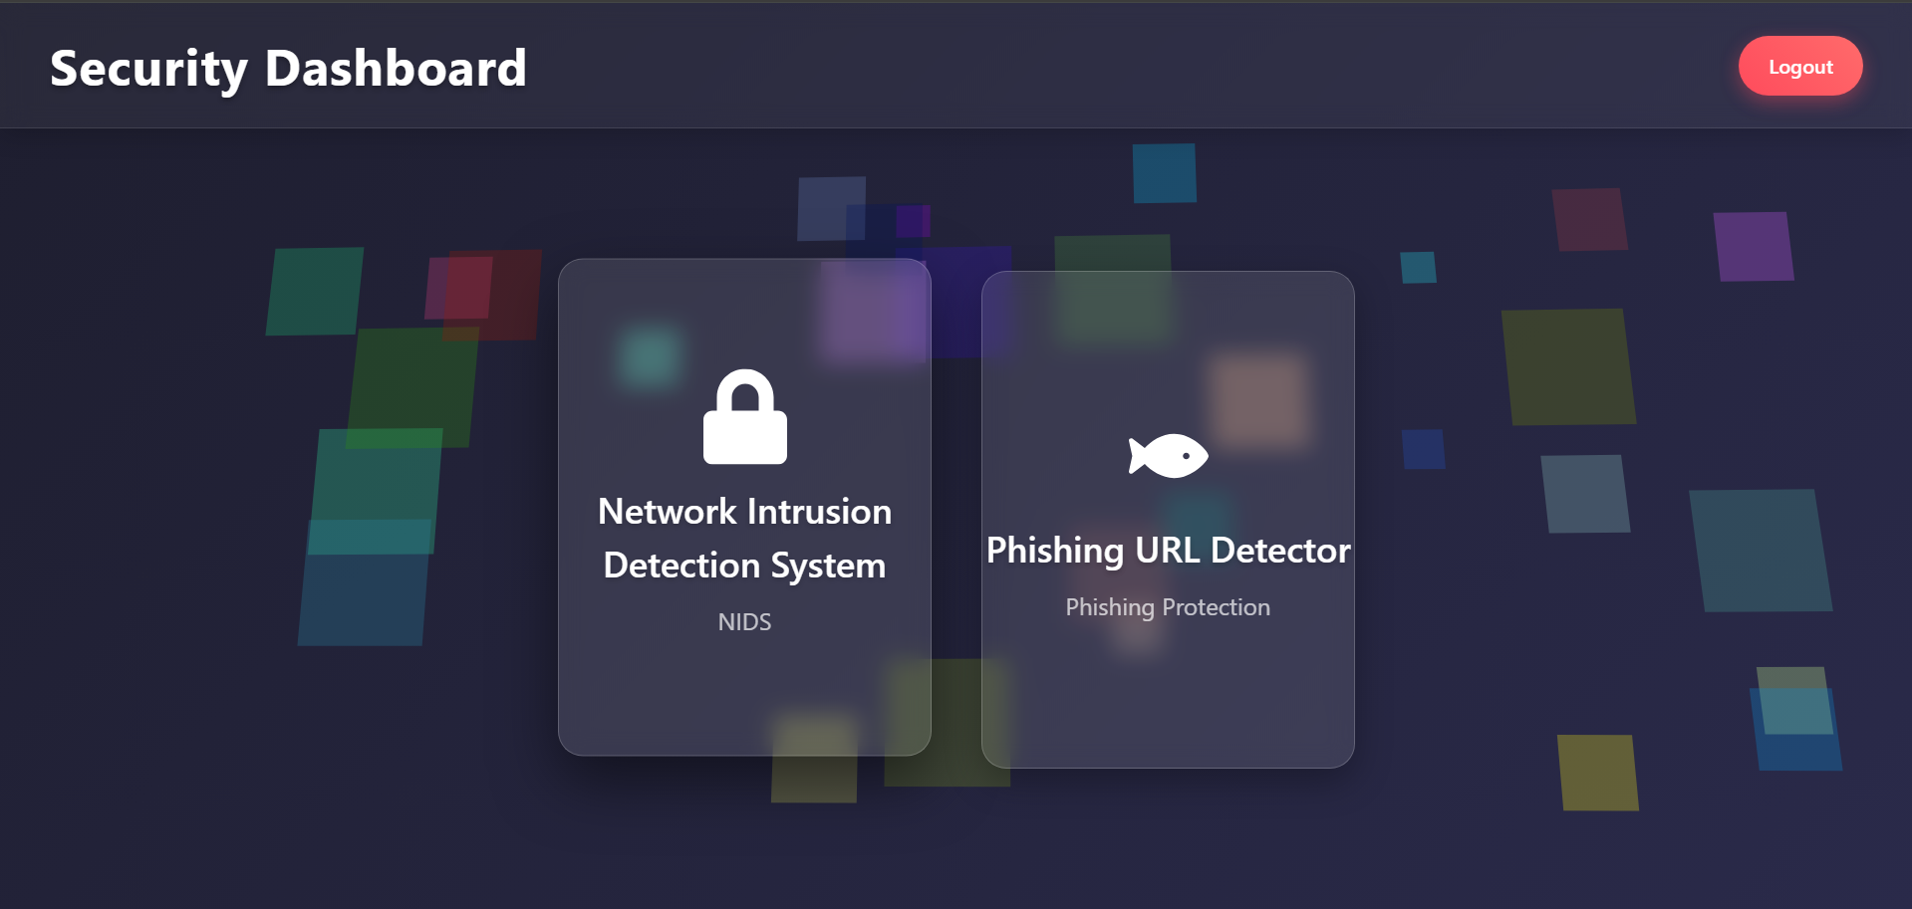
Project Description: Deployment
This image shows our dashboard where you can choose between NIDS and Phishing

Slide 13
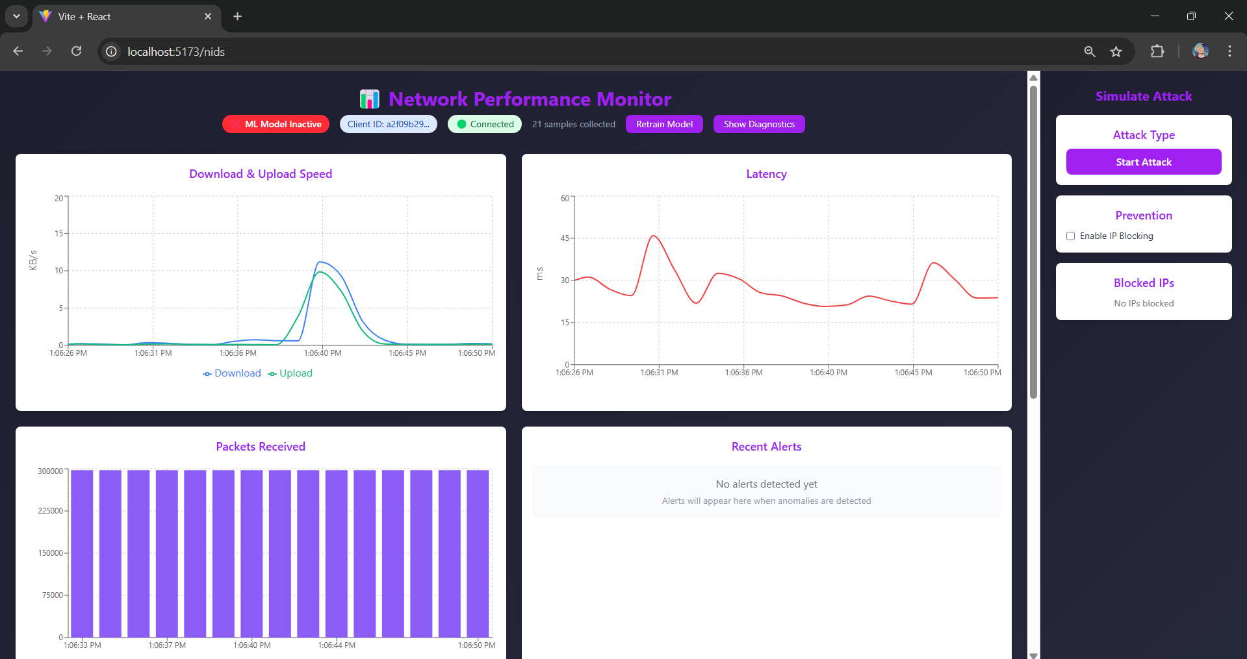
This image shows our NIDS working where you can see your network statics and can simulate the attack.

Slide 14
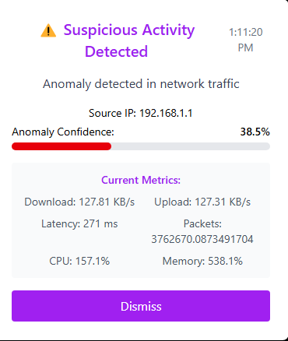
In this image as you can see our model can detect the dos attack.

Slide 15
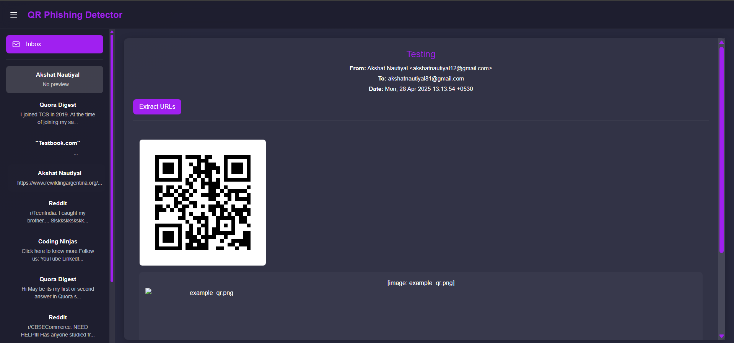
This image shows the phishing working where you can extract and scan the URL from QR and then our model can check whether this URL is safe or not.

Slide 16
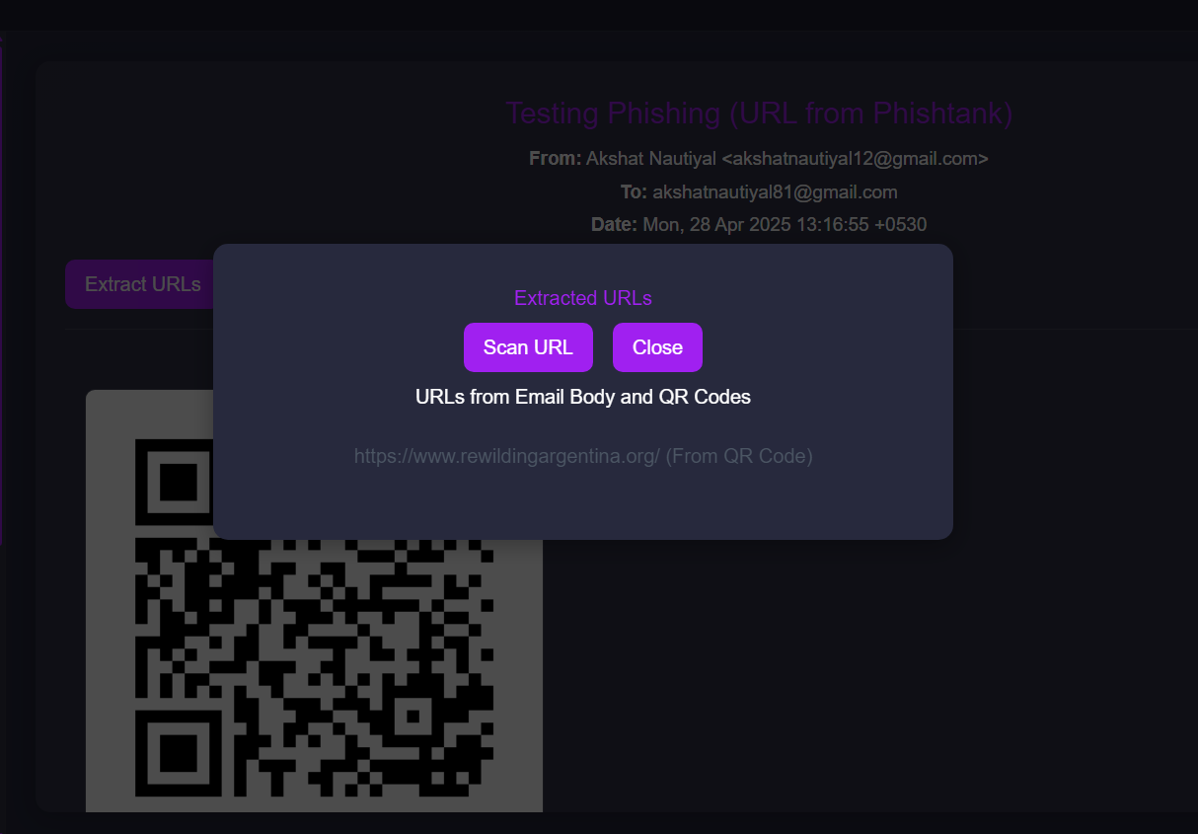
As you can see in this image, we can extract the URL from QR

Slide 17
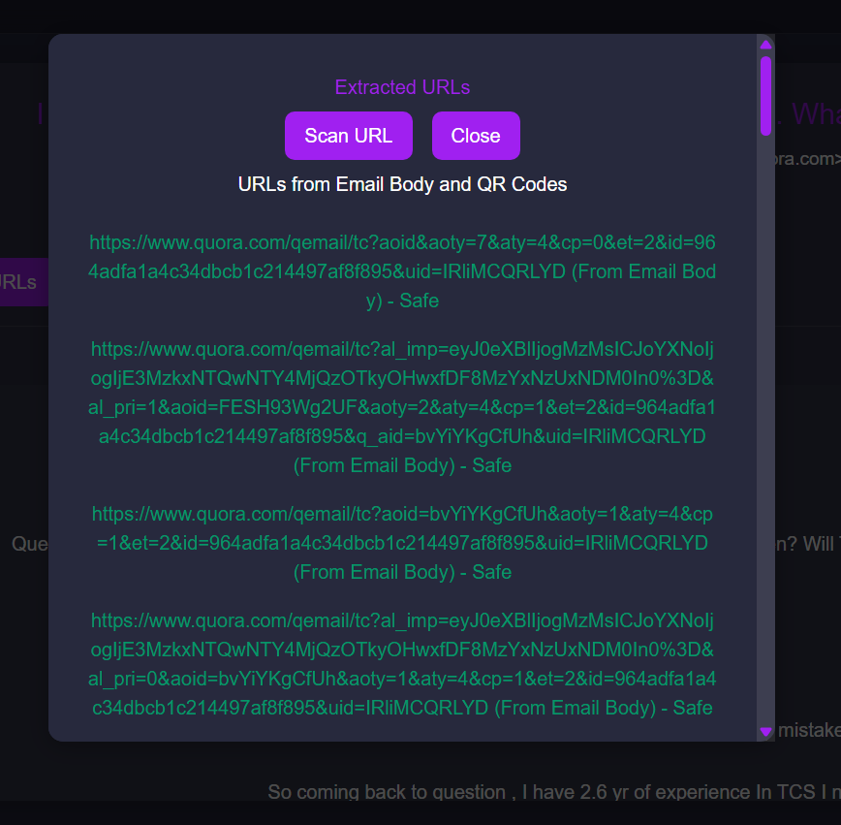
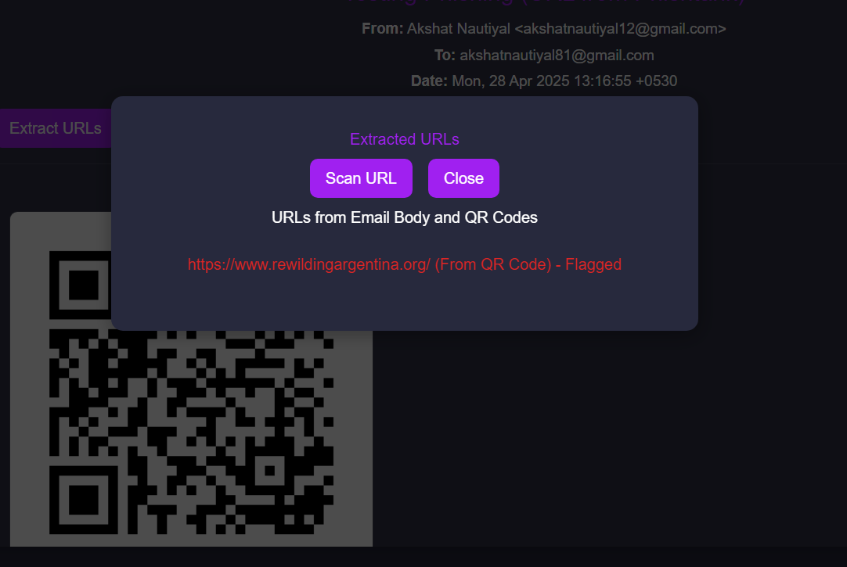
This image shows unsafe URL (Flagged in Red Color)
This image shows safe URL (Flagged in Green Color)

Slide 18
Results
NIDS: Accurate real-time anomaly detection with minimal false positives.
Phishing: Random Forest outperformed others in test accuracy and low false positive rate.

Slide 19
Conclusion
Hybrid architecture enhances threat detection and user interface.
Reduces false positives and human dependency.

Slide 20
Future Work
Add active mitigation for DoS and zero-day attacks.
Improve phishing model accuracy with richer datasets.
Improve User Interface.

Slide 21
Reference
[1] Lee, M. C., Lin, J. C., & Katsikas, S. (2024, August). Impact of recurrent neural networks and deep learning frameworks on real-time lightweight time series anomaly detection. In International Conference on Information and Communications Security (pp. 228-247). Singapore: Springer Nature Singapore.
[2] Hui, B., & Chiew, K. L. (2025). An improved network intrusion detection method based on cnn-lstm-sa. Journal of Advanced Research in Applied Sciences and Engineering Technology, 44(1), 225-238.
[3] Garje, A., Tanwani, N., Kandale, S., Zope, T., & Gore, S. (2021). Detecting phishing websites using machine learning. International Journal of Creative Research Thoughts, 9, 2320-2882.
[4] Aslam, S., Aslam, H., Manzoor, A., Chen, H., & Rasool, A. (2024). AntiPhishStack: LSTM-based stacked generalization model for optimized phishing URL detection. Symmetry, 16(2), 248.
[5] Seo, W., & Pak, W. (2021). Real-time network intrusion prevention system based on hybrid machine learning. IEEE Access, 9, 46386-46397.
[6] Zara, U., Ayub, K., Khan, H. U., Daud, A., Alsahfi, T., & Gulzar, S. (2024). Phishing website detection using deep learning models. IEEE Access.

